Slide 1
The BW-Tree: A B-tree for New Hardware Platforms
Justin Levandoski
David Lomet
Sudipta Sengupta

Slide 2
An Alternate Title
“The BW-Tree: A Latch-free, Log-structured B-tree for Multi-core Machines with Large Main Memories and Flash Storage”
BW = “Buzz Word”

Slide 3
The Buzz Words (1)
B-tree
Key-ordered access to records
Efficient point and range lookups
Self balancing
B-link variant (side pointers at each level)
In
Memory
data
data
data
…
data
data
data
On Disk

Slide 4
The Buzz Words (2)
Multi-core + large main memories
Latch (lock) free
Worker threads do not set latches for any reason
Threads never block
No data partitioning
“Delta” updates
No updates in place
Reduces cache invalidation
Flash storage
Good at random reads and sequential reads/writes
Bad at random writes
Use flash as append log
Implement novel log-structured storage layer over flash

Slide 5
Outline
Overview
Deployment scenarios
Latch-free main-memory index (Hekaton)
Deuteronomy
Bw-tree architecture
In-memory latch-free pages
Latch-free structure modifications
Cache management
Performance highlights
Conclusion

Slide 6
Multiple Deployment Scenarios
Standalone (highly concurrent) atomic record store
Fast in-memory, latch-free B-tree
Data component (DC) in a decoupled “Deuteronomy” style transactional system

Slide 7
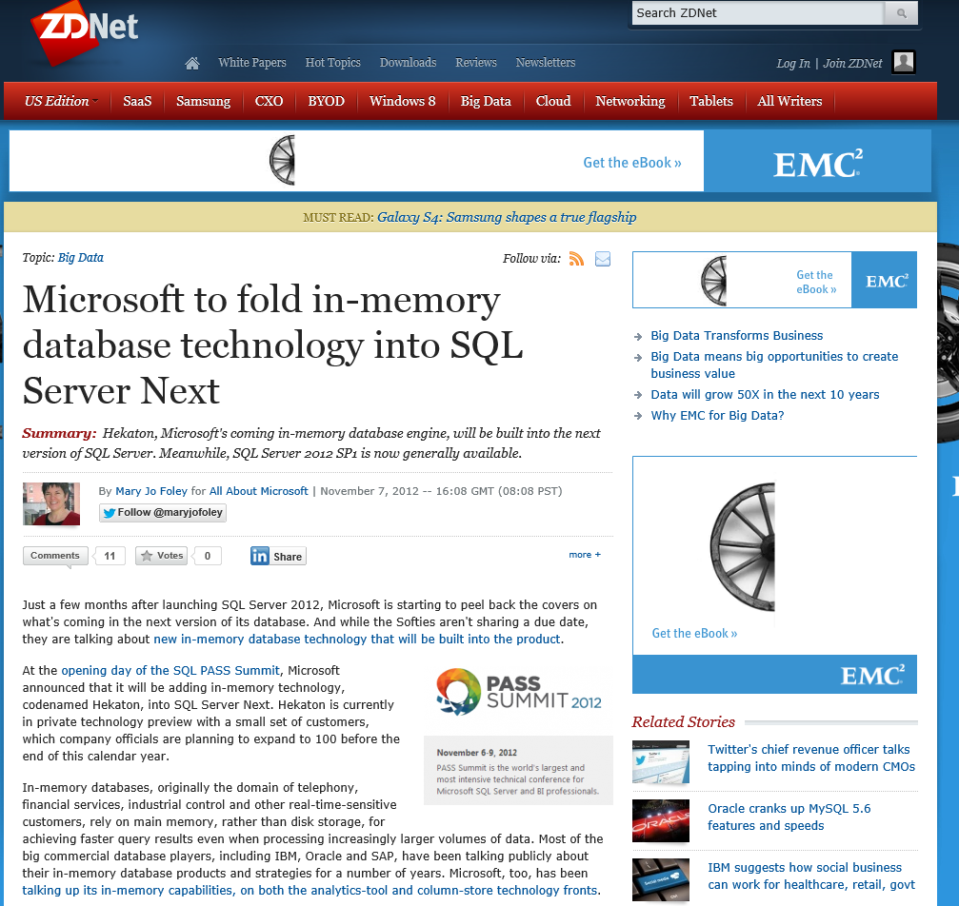
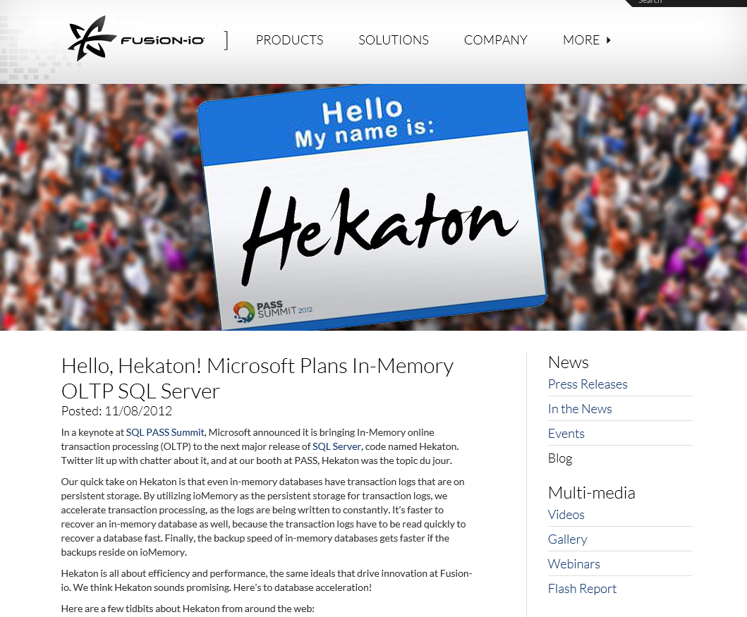
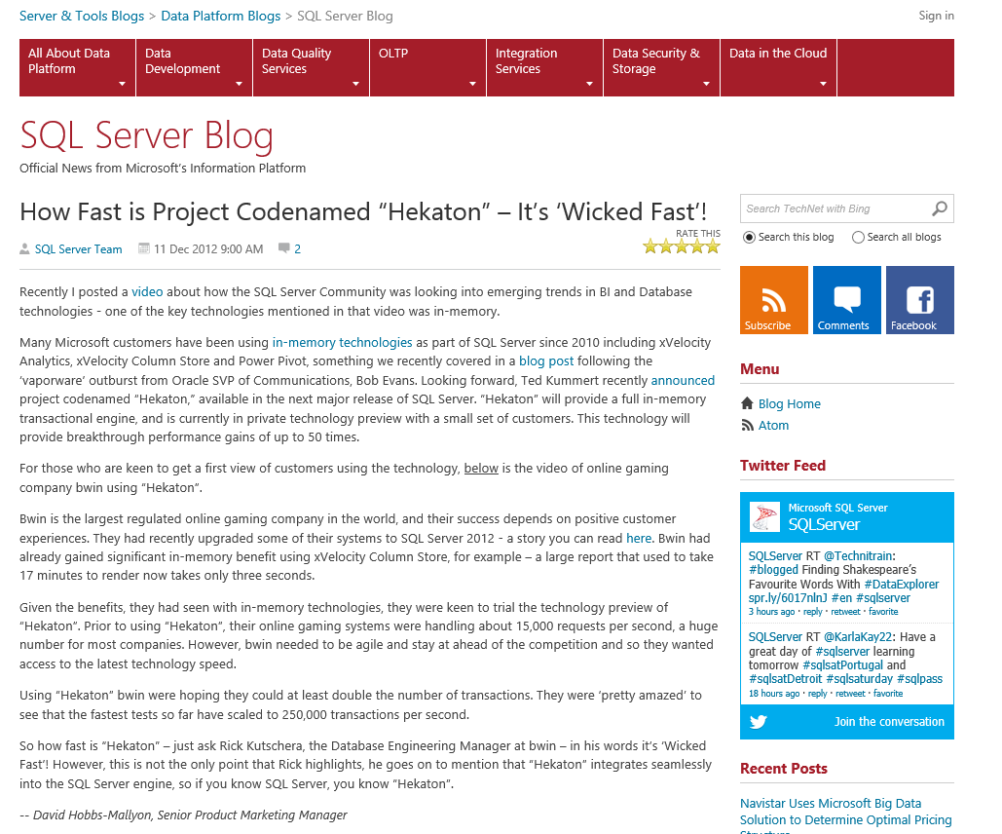
Microsoft SQL Server Hekaton
Main-memory optimized OLTP engine
Engine is completely latch-free
Multi-versioned, optimistic concurrency control (VLDB 2012)
Bw-tree is the ordered index in Hekaton
http://research.microsoft.com/main-memory_dbs/

Slide 8
Deuteronomy
Client Request
Interaction Contract
Transaction Component (TC)
Guarantee ACID Properties
No knowledge of physical data storage
Reliable messaging “At least once execution” multiple sends
Idempotence “At most once execution”
LSNs
Causality “If DC remembers message, TC must also”
Write ahead log (WAL) protocol
Contract termination “Mechanism to release contract”
Checkpointing
Logical locking and logging
Record
Operations
Control Operations
Data Component (DC)
Physical data storage
Atomic record modifications
Data could be anywhere (cloud/local)
Storage
http://research.microsoft.com/deuteronomy/

Slide 9
Outline
Overview
Deployment scenarios
Bw-tree architecture
In-memory latch-free pages
Latch-free structure modifications
Cache management
Performance highlights
Conclusion

Slide 10
Bw-Tree Architecture
Focus of this talk
B-Tree Layer
API
B-tree search/update logic
In-memory pages only
Cache
Layer
Logical page abstraction for B-tree layer
Brings pages from flash to RAM as necessary
Flash
Layer
Sequential writes to log-structured storage
Flash garbage collection

Slide 11
Outline
Overview
Deployment scenarios
Bw-tree architecture
In-memory latch-free pages
Latch-free structure modifications
Cache management
Performance highlights
Conclusion

Slide 12
Mapping Table and Logical Pages
Mapping Table
PID | Physical Address
In-Memory
Index page
Index page
Data page
On Flash
Data page
flash/mem
flag
address
1 bit
63 bits
Pages are logical, identified by mapping table index
Mapping table
Translates logical page ID to physical address
Important for latch-free behavior and log-structuring
Isolates update to a single page

Slide 13

Compare and Swap
Atomic instruction that compares contents of a memory location M to a given value V
If values are equal, installs new given value V’ in M
Otherwise operation fails
Address
New Value
M
X
30
20
CompareAndSwap(&M, 20, 40)
CompareAndSwap(&M, 20, 30)
Compare Value

Slide 14
Delta Updates
Mapping Table
PID | Physical Address
P
Δ: Delete record 48
Δ: Insert record 50
Page P
Each update to a page produces a new address (the delta)
Delta physically points to existing “root” of the page
Install delta address in physical address slot of mapping table using compare and swap

Slide 15
Update Contention
Δ: Update record 35
Δ: Insert Record 60
Mapping Table
PID | Physical Address
P
Δ: Delete record 48
Δ: Insert record 50
Page P
Worker threads may try to install updates to same state of the page
Winner succeeds, any losers must retry
Retry protocol is operation-specific (details in paper)

Slide 16
Delta Types
Delta method used to describe all updates to a page
Record update deltas
Insert/Delete/Update of record on a page
Structure modification deltas
Split/Merge information
Flush deltas
Describes what part of the page is on log-structured storage on flash

Slide 17
In-Memory Page Consolidation
Mapping Table
Δ: Update record 35
PID | Physical Address
P
Δ: Delete record 48
Δ: Insert record 50
Page P
“Consolidated” Page P
Delta chain eventually degrades search performance
We eventually consolidate updates by creating/installing new search-optimized page with deltas applied
Consolidation piggybacked onto regular operations
Old page state becomes garbage

Slide 18
Garbage Collection Using Epochs
Thread joins an epoch prior to each operation (e.g., insert)
Always posts “garbage” to list for current epoch (not necessarily the one it joined)
Garbage for an epoch reclaimed only when all threads have exited the epoch (i.e., the epoch drains)
Current Epoch
Epoch 1
Epoch 2
Members
Members
Thread 1
Thread 3
Thread 2
Garbage Collection List
Garbage Collection List
Δ
Δ
Δ
Δ
Δ
Δ
Δ

Slide 19
Outline
Overview
Deployment scenarios
Bw-tree architecture
In-memory latch-free pages
Latch-free structure modifications
Cache management
Performance highlights
Conclusion

Slide 20
Latch-Free Node Splits
Mapping Table
Index Entry Δ
PID | Physical Address
2
Split Δ
Page 1
Page 2
Page 3
Page 4
Logical pointer
4
Physical pointer
Page sizes are elastic
No hard physical threshold for splitting
Can split when convenient
B-link structure allows us to “half-split” without latching
Install split at child level by creating new page
Install new separator key and pointer at parent level

Slide 21
Outline
Overview
Deployment scenarios
Bw-tree architecture
In-memory latch-free pages
Latch-free structure modifications
Cache management
Performance highlights
Conclusion

Slide 22
Cache Management
Write sequentially to log-structured store using large write buffers
Page marshalling
Transforms in-memory page state to representation written to flush buffer
Ensures correct ordering
Incremental flushing
Usually only flush deltas since last flush
Increased writing efficiency

Slide 23
Representation on LSS
Sequential log
Base page
Mapping table
Base page
Base page
Δ-record
.
.
.
.
.
.
Write ordering in log
Δ-record
RAM
Δ-record
Flash Memory

Slide 24
Outline
Overview
Deployment scenarios
Bw-tree architecture
In-memory latch-free pages
Latch-free structure modifications
Cache management
Performance highlights
Conclusion

Slide 25
Performance Highlights - Setup
Experimented against
BerkeleyDB standalone B-tree (no transactions)
Latch-free skiplist implementation
Workloads
Xbox
27M get/set operations from Xbox Live Primetime
94 byte keys, 1200 byte payloads, read-write ratio of 7:1
Storage Deduplication
27M deduplication chunks from real enterprise trace
20-byte keys (SHA-1 hash), 44-byte payload, read-write ratio of 2.2:1
Synthetic
42M operations with keys randomly generated
8-byte keys, 8-byte payloads, read-write ratio of 5:1

Slide 26
Vs. BerkeleyDB

Slide 27
Vs. Skiplists
 | Bw-Tree | Skiplist
Synthetic workload | 3.83M Ops/Sec | 1.02 M Ops/Sec

Slide 28
Outline
Overview
Deployment scenarios
Bw-tree architecture
In-memory latch-free pages
Latch-free structure modifications
Cache management
Performance highlights
Conclusion

Slide 29
Conclusion
Introduced a high performance B-tree
Latch free
Install delta updates with CAS (do not update in place)
Mapping table isolates address change to single page
Log structured (details in another paper)
Uses flash as append log
Updates batched and written sequentially
Flush queue maintains ordering
Very good performance

Slide 30
Questions?

